Slide 1
Java Servlets
Java Server Pages (JSP)
Yi Lin

Slide 2
Overview of History
CGI
(in C)
CGI
(java, C++)
Template
(ASP, PHP)
complexity
Speed, Security
Servlet
JSP

Slide 3
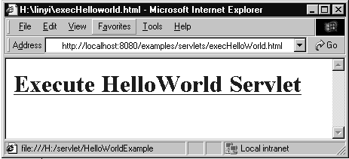
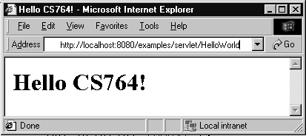
HelloWorld
import java.io.*;
import javax.servlet.*;
import javax.servlet.http.*;
public class HelloWorld extends HttpServlet {
public void doGet(HttpServletRequest request,
HttpServletResponse response)
throws IOException, ServletException
{
response.setContentType("text/html");
PrintWriter out = response.getWriter();
out.println("<html>");
out.println("<body>");
out.println("<head>");
out.println("<title>Hello CS764!</title>");
out.println("</head>");
out.println("<body>");
out.println("<h1>Hello CS764!</h1>");
out.println("</body>");
out.println("</html>");
out.close();
}
}

Slide 4
<html><head></head>
<body>
<a href="../servlet/HelloWorld">
<h1>Execute HelloWorld Servlet</h1>
</a>
</body>
</html>
<html>
<head>
<title>Hello CS764!</title></head>
<body>
<h1>Hello CS764!</h1>
</body>
</html>

Slide 5
Client - Server - DB
Trigger Servlet, JSP (Request)
Client (browser)
Through internet
Web server (Apache, JWS)
Return html file (Response)
Request data
JDBC, intranet
Return data
Database server (DB2)

Slide 6
Life Cycle of Servlet
servlet
GenericServlet
HttpServlet
init(ServletConfig);
doGet(HttpServletRequest,
HttpServletResponse);
service(ServletRequest,
ServletResponse);
doPost(HttpServletRequest,
HttpServletResponse);
…….
destroy();

Slide 7
Interaction with Client
HttpServletRequest
  String getParameter(String)
  Enumeration getParameters(String[])
HttpServletResponse
  Writer getWriter()
  ServletOutputStream getOutputStream()
Handling GET and POST Requests

Slide 8
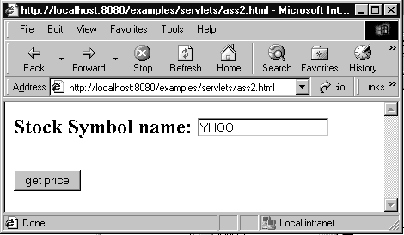
Assignment 2: Get Stock Price
Ass2.html
<html><head></head>
<body>
<form action="../servlet/Ass2Servlet" method=POST>
<h2>Stock Symbol name:
<input type=text name="stockSymbol"></h2><br>
<input type="submit" value = "get price">
</form>
</body></html>
Client Side

Slide 9
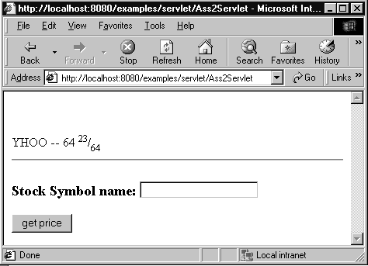
Ass2Servlet
import java.io.*;
import java.util.*;
import javax.servlet.*;
import javax.servlet.http.*;
public class Ass2Servlet extends HttpServlet {
public void doPost(HttpServletRequest request,
HttpServletResponse res)
throws IOException, ServletException
{
res.setContentType("text/html");
PrintWriter out = res.getWriter();
String stockSymb = request.getParameter("stockSymbol");
StockGrabber sg = new StockGrabber();
sg.setStockSymbol(stockSymb); // Set the stock symbol as “input”
String stockPrice = sg.getPrice();// Get the price of stock
System.out.println("After StockGrabber.getPrice --"+stockPrice);// Debug
out.println("<html><head></head><body><br><br>");
out.println(stockSymb + " -- " + stockPrice);
out.println("<hr>");
out.println("<form action=\"../servlet/Ass2Servlet\" method=POST>");
out.println("<h3>Stock Symbol name: <input type=text name=\"stockSymbol\"></h3>");
out.println("<input type=submit value=\"get price\">");
out.println("</form>");
out.println("</body></html>");
}
}

Slide 10
Java Server Pages (JSP)
Client’s Computer
1.Browser requests HTML
7. Server sends HTML
back to browser
Server
6. Java Engine sends HTML to server
servlet
servlet
2. Server sends requests to Java Engine
class
5.The servlet runs and generates HTML
3. If needed, the Java Engine
reads the .jsp file
Bean
4. The JSP is turned into a
servlet, compiled, and loaded
Java Engine

Slide 11
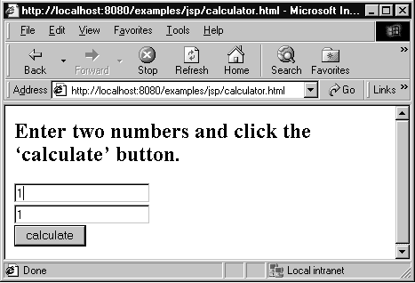
A First JSP
<html>
<head></head>
<body>
<p>Enter two numbers and click the
‘calculate’ button.</p>
<form action=“calculator.jsp” method=“get”>
<input type=text name=value1><br>
<input type=text name=value2 ><br>
<input type=submit name=calculate value=calculate>
</form>
</body>
</html>
Calculator.html

Slide 12
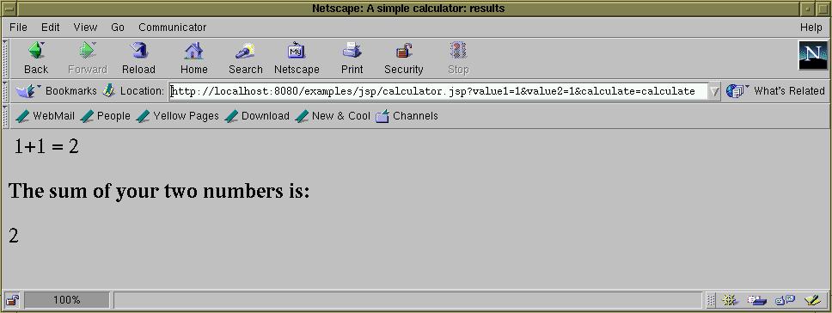
<html>
<head><title>A simple calculator: results</title></head>
<body>
<%-- A simpler example 1+1=2 --%>
1+1 = <%= 1+1 %>
<%-- A simple calculator --%>
<h2>The sum of your two numbers is:</h2>
<%= Integer.parseInt(request.getParameter("value1")) +
Integer.parseInt(request.getParameter("value2")) %>
</body>
</html>
Calculator.jsp

Slide 13
JSP Tags
Comments <%-- …...text…... --%>
Declaration <%! int i; %>
<%! int numOfStudents(arg1,..) {} %>
Expression <%= 1+1 %>
Scriptlets <% … java code … %>
include file <%@ include file=“*.jsp” %>
…...

Slide 14
Using Java Bean
Declaration
1. <jsp:useBean id=“bean1” class=“Bean1”/>
2. <jsp:useBean id=“bean1” class=“Bean1” name=“serBean” type=“SerBean1”/>
Setting property
1. <jsp:setProperty name=“bean1” property=“color” value=“red”/>
2. <jsp:setProperty name=“bean1” property=“color”/>
3. <jsp:setProperty name=“bean1” property=“color” param=“bgColor”/>
4. <jsp:setProperty name=“bean1” property=“*”/>
Getting property
1. <jsp:getProperty name=“bean1” property=“color”/>
2. <%=bean1.getColor() %>

Slide 15
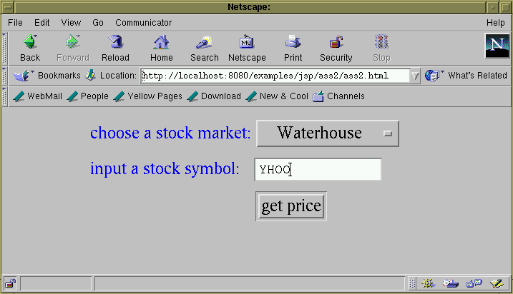
Assg2
example
<html>
<head></head>
<body>
<center>
<table border = 0>
<form action=ass2.jsp method = POST>
<tr><td><font color=blue>choose a stock market:</font></td>
<td><select name="stockMarket">
<option value="Waterhouse">Waterhouse</option>
<option value="Yahoo">Yahoo</option>
<option value="ChicagoStockex">Chicago Stockex</option>
<option value="Reuters">Reuters</option>
</select></td>
</tr>
<tr><td><font color = blue>input a stock symbol:</font></td>
<td><input type="edit" name="stockSymbol" size=15></td>
</tr>
<tr><td></td><td><input type="submit" value = "get price"></td></tr>
</table>
</form></center>
</body></html>
Client side
Ass2.html

Slide 16
ass2.jsp
<html><head>
<jsp:useBean id="ass2" scope="session" class="ass2.StockGrabber" />
<jsp:setProperty name="ass2" property="*" />
</head>
<body><h2><%
ass2.processInput();
ass2.getPrice();
%>
<center><table border=5>
<tr><td># of data</td> <td>Stock Market</td> <td>Stock Symbol</td> <td>Stock Price </td>
</tr><%
String[] stockMarkets = ass2.getStockMarkets();
String[] symbols = ass2.getSymbols();
String[] prices = ass2.getPrices();
for(int i=0; i<prices.length; i++){
%>
<tr><td> <%= i+1 %> </td>
<td> <%= stockMarkets[i] %> </td>
<td> <%= symbols[i] %> </td>
<td><font color=red><%= prices[i] %></font></td>
</tr><%
}
%>
</table>
</center>
</h2>
<hr><%@include file="ass2.html" %></html>
<jsp:setProperty name=“ass2” property=“stockSymbol”/>
<jsp:setProperty name=“ass2” property=“stockMarket”/>
Server side

Slide 17
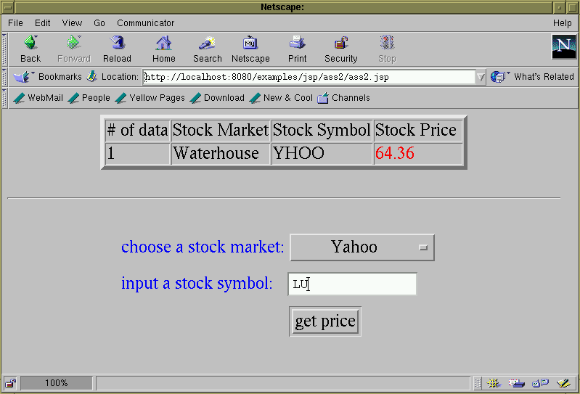
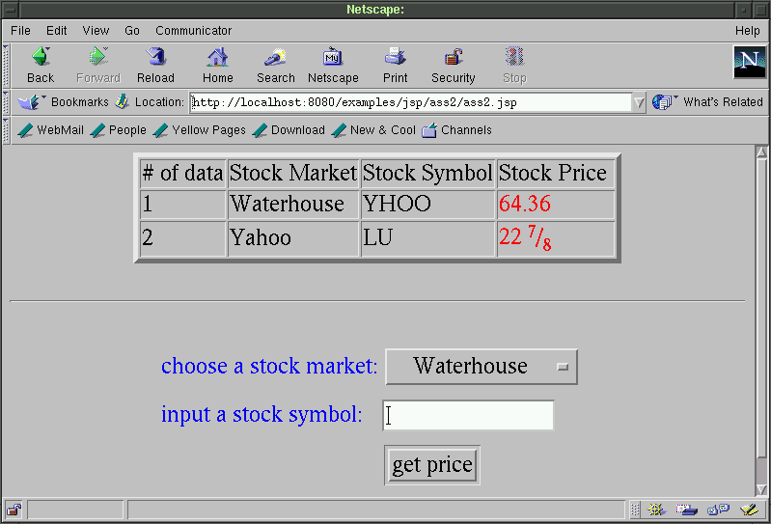

Slide 18
Without using JDBC
Public class StockGrabber {
...
public void processInput(){
if(stockMarket.compareTo("Waterhouse")==0){
setPrePriceString("<!--Last-->");
setPostPriceString("</FONT>");
setUrlPrefix("http://research.tdwaterhouse.com/
waterhouse/quote.asp?ticker=");
}
else if(stockMarket.compareTo("Yahoo")==0){
setPrePriceString("<td nowrap><b>");
setPostPriceString("</b></td>");
setUrlPrefix("http://finance.yahoo.com/q?s=");
}
...
else if(...){}
...
else{...}
}
...
}

Slide 19
Using JDBC --> Database
import java.sql.*;
Public class StockGrabber {
...
public void processInput(){
try {
Class.forName("sun.jdbc.odbc.JdbcOdbcDriver");
String sourceURL="jdbc:odbc:stockInfo";
Connection databaseConnection=DriverManager.getConnection(sourceURL);
Statement statement=databaseConnection.createStatement();
ResultSet info =statement.executeQuery(
"select tPrePriceStr, tPostPriceStr, tUrlPrefix
from stockMarketData
where tStockMarket = stockMarket”);
while(inf.next())
{
prePriceString = info.getString(”tPrePriceStr");
postPriceString = info.getString(“tPostPriceStr”);
urlPrefix = info.getString(“tUrlPrefix”);
}
}
catch(SQLException e){ ... }
...
}
}

